Slide 1
Data Structures And Algorithms

Slide 2
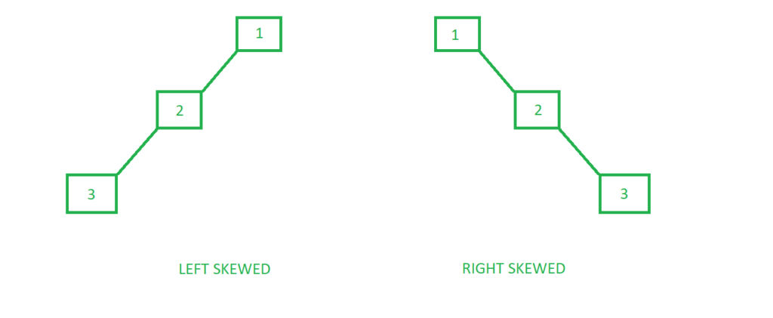
Problem with BST
Typically, a binary search tree will support insertion, deletion, and search operations.
The cost of each operation depends upon the height of the tree – in the worst case, an operation will need to traverse all the nodes on the path from the root to the deepest leaf.
A problem starts to emerge here if our tree is heavily skewed.

Slide 3
Self balancing trees
AVL Trees
Red Black Trees
Splay Trees

Slide 4
Applications of self balanced trees
Most in-memory sets and dictionaries are stored using AVL trees.
Database applications, where insertions and deletions are less common but frequent data lookups are necessary, also frequently employ AVL trees.
In addition to database applications, it is employed in other applications that call for better searching.
A balanced binary search tree called an AVL tree uses rotation to keep things balanced.
It may be used in games with plotlines as well.
It is mostly utilized in business sectors where it is necessary to keep records on the employees that work there and their shift changes.

Slide 5
AVL Trees
AVL Tree is invented by GM Adelson - Velsky and EM Landis in 1962. The tree is named AVL in honour of its inventors.
AVL Tree can be defined as balanced binary search tree
In AVL trees, each node is associated with a balance factor which is calculated by subtracting the height of its right sub-tree from that of its left sub-tree.
Tree is said to be balanced if balance factor of each node is in between -1 to 1, otherwise, the tree will be unbalanced and need to be balanced.

Slide 6
Balance factor
Balance factor of a node in an AVL tree is the difference between the height of the left subtree and that of the right subtree of that node.
Balance Factor = Height of Left Subtree - Height of Right Subtree
or
Balance Factor = Height of Right Subtree - Height of Left Subtree

Slide 7
Balance factor
In AVL trees, Balance Factor must be at most one.
Once the difference exceeds one, the tree automatically executes the balancing algorithm until the difference becomes one again.
If the value of balance factor is 0, it means that height of both subtrees are equal.
If the value of balance factor is -1 or +1 it means that its left or right subtree height is not equal. However, the tree is in balanced condition.
Tree is not balanced if the value exceeds +1 or -1

Slide 8
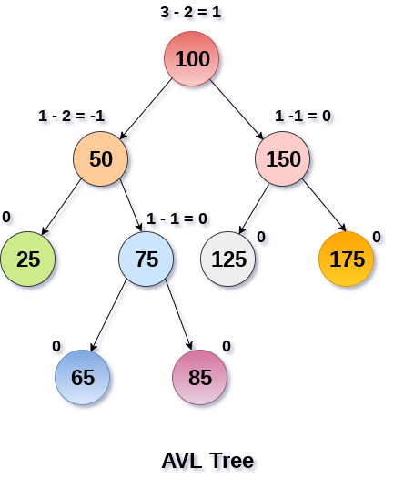
Avl tree

Slide 9
How to balance the tree?
If the balance factor is not 0, +1, -1 then the tree is needed to be balanced.
Basically, balance factor is checked each time an item is inserted or deleted from the tree
To make a balanced BST/ AVL tree, rotations need to be performed.
Hence, at each insertion or deletion balance factor of the tree is checked and rotation is performed if needed

Slide 10
Rotations in AVL trees
There are following types of rotations:
Single Rotation
Left Rotation
Right Rotation
Double Rotation
Left Right Rotation
Right Left Rotation

Slide 11
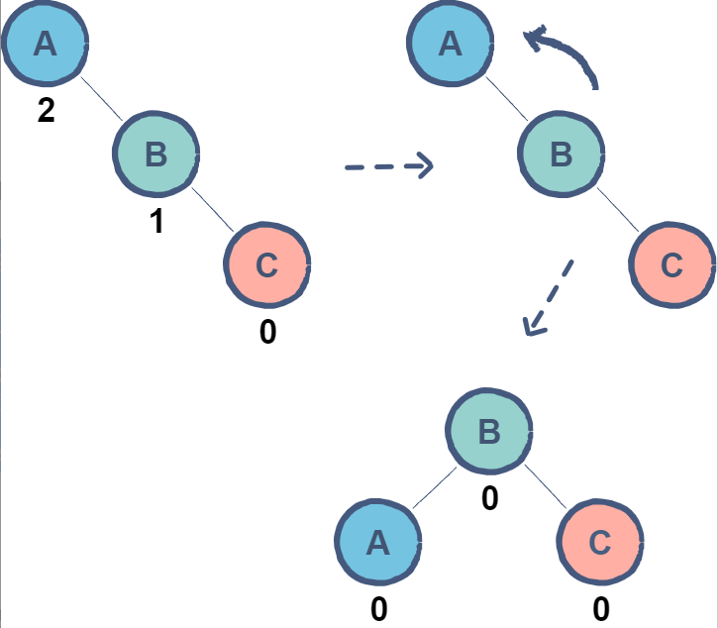
Left rotation
When RR imbalance occurs, then left rotation is performed
A single rotation applied when a node is inserted in the right subtree of a right subtree.
In the given example, node A has a balance factor of 2 after the insertion of node C.
By rotating the tree left, node B becomes the root resulting in a balanced tree.

Slide 12
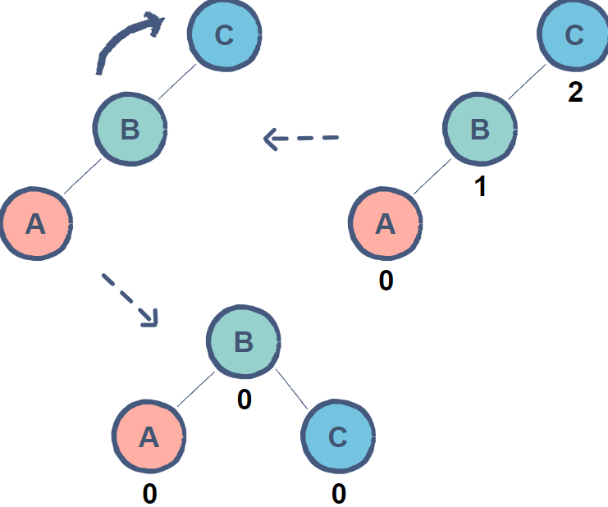
Right rotation
When LL imbalance occurs, then right rotation is performed
A single rotation applied when a node is inserted in the left subtree of a left subtree.
In the given example, node A has a balance factor of 2 after the insertion of node C.
By rotating the tree left, node B becomes the root resulting in a balanced tree.

Slide 13
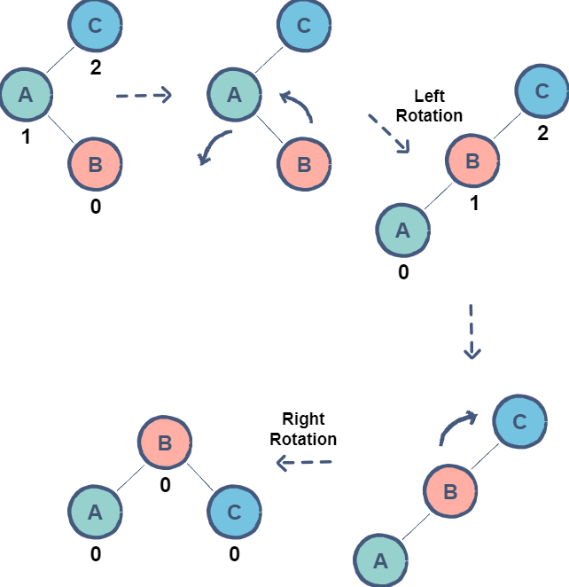
Left right rotation
A double rotation in which a left rotation is followed by a right rotation.
Convert the LR rotation to LL imbalance using left rotation
Then solve the LL imbalance using right rotation
In the given example, node B is causing an imbalance resulting in node C to have a balance factor of 2. As node B is inserted in the right subtree of node A, a left rotation needs to be applied.
Now, all we have to do is apply the right rotation as shown before to achieve a balanced tree.

Slide 14
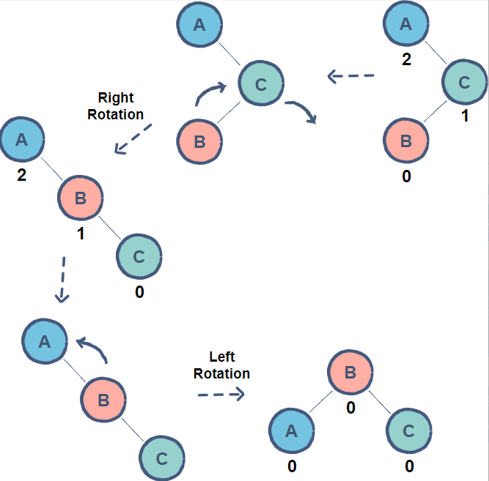
right left rotation
A double rotation in which a right rotation is followed by a left rotation.
Convert the RL rotation to RR imbalance using right rotation
Then solve the RR imbalance using left rotation
In the given example, node B is causing an imbalance resulting in node A to have a balance factor of 2. As node B is inserted in the left subtree of node C, a right rotation needs to be applied.
Now, by applying the left rotation as shown before, we can achieve a balanced tree.

